Slide 1


Slide 2

EMPLOYEES PERFORMANCE REVIEW SYSTEM
FINAL PROJECT

Slide 3

TEAM MEMBERS
Abdulrahman Bahumaish
Khalid Zaki Bahashwaan
Ibraheem Mohammed Alhiqi
Mohammed Salah Bin Shabit
Hassan Mohammed Barafaa
Omar Awadh Bin Shabit

Slide 4

OUR SUPERVISIOR
Dr. Mohammed Mobark Wahdeen

Slide 5
CHAPTER I
01
INTRODUCTION
04
PROJECT SCOPE
02
PROBLEM STATEMENT
05
IMPORTANT OF PROJECT
03
OBJECTIVES
06
SYSTEM REQUIRMENTS

Slide 6
INTRODUCTION
In today’s dynamic work environment, understanding and enhancing employee performance is crucial for organizational success. The Employee Performance Review System serves as a structured framework designed to facilitate open communication between HR, managers and employees fostering a culture of continuous improvement and professional development.

Slide 7

PROBLEM STATEMENT
The current performance review process for employees at companies is time-consuming, inconsistent, and lacks transparency.

Slide 8

OBJECTIVES
Creating web application to solve the problem of performance review and tracking progress.

Slide 9

PROJECT SCOPE
This system is limited to small to med-sized companies that are somewhat compatible with the system components.

Slide 10

IMPORTANT OF PROJECT
Ensuring fair and transparent evaluations, aligning individual goals with company objectives, promoting continuous improvement, enhancing employee engagement ..etc.

Slide 11

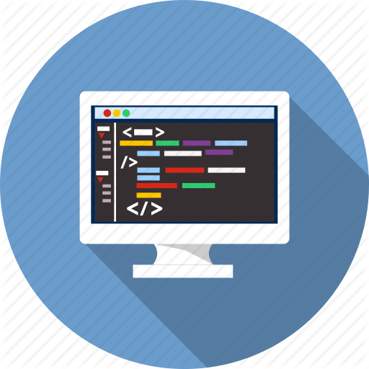


SYSTEM REQUIRMENETS
Laravel Framework Basic Structure of the system
Laravel Breeze For Login And Sign Up
MySQL Database For The System
JavaScript (Vue.js) For System Design And Interactions

Slide 12
CHAPTER II
01
INTRODUCTION
04
BACKGROUND

Slide 13
INTRODUCTION
In this chapter, related works will be presented. We will list some of the related works on the internet and mention its characteristics, advantages and disadvantages.

Slide 14
BACKGROUND
Similar systems & projects.
Trakstar
15Five
Lattice

Slide 15
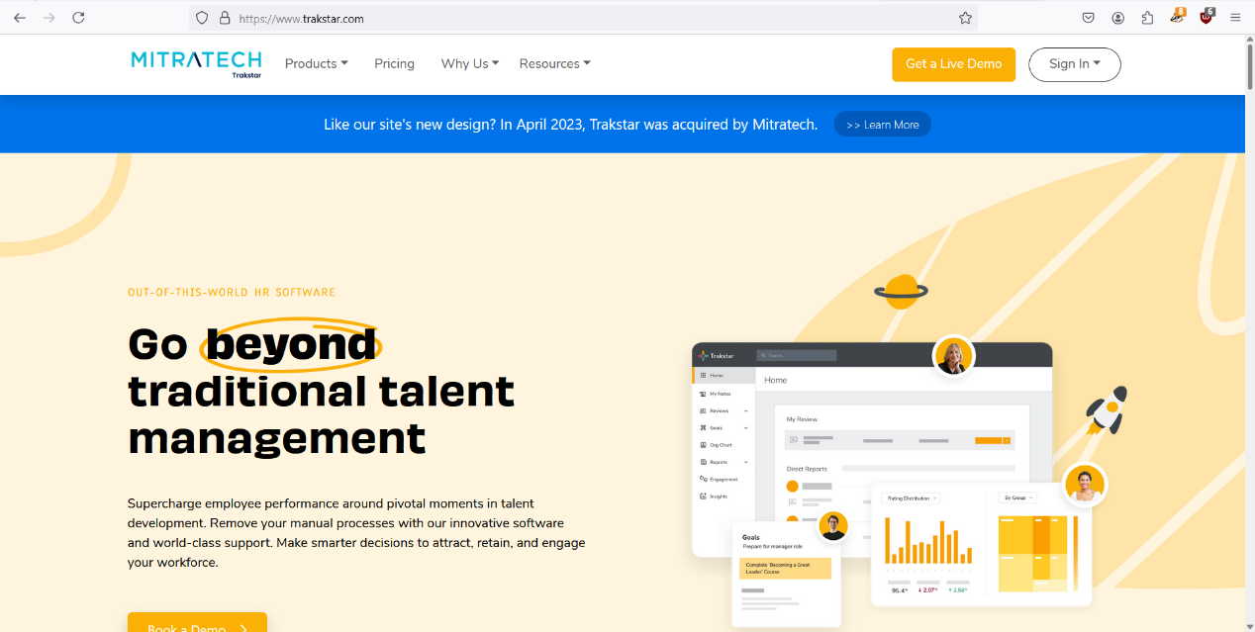
Trakstar

Slide 16
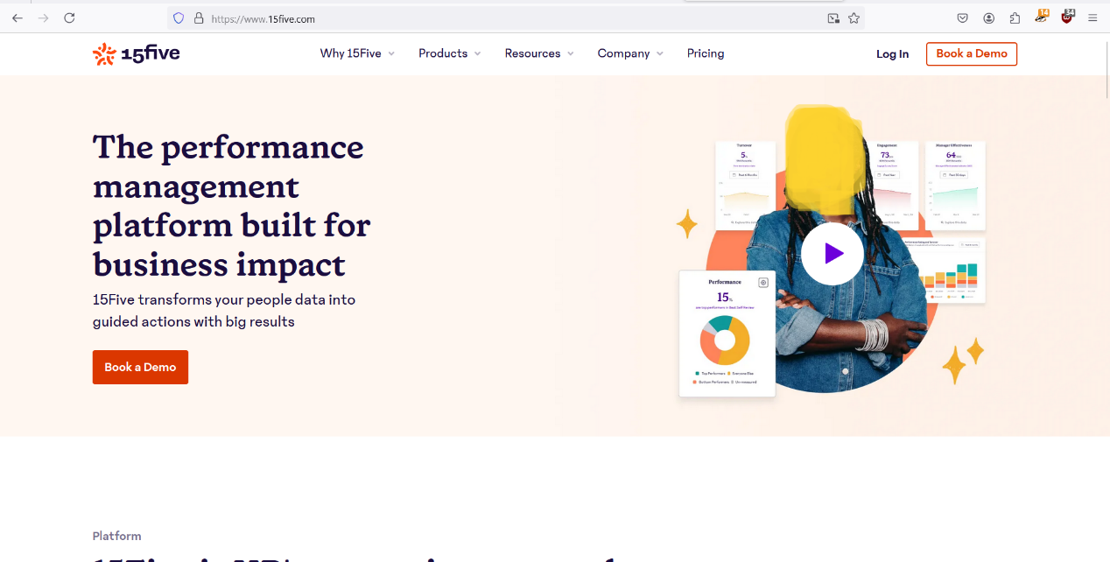
15Five

Slide 17
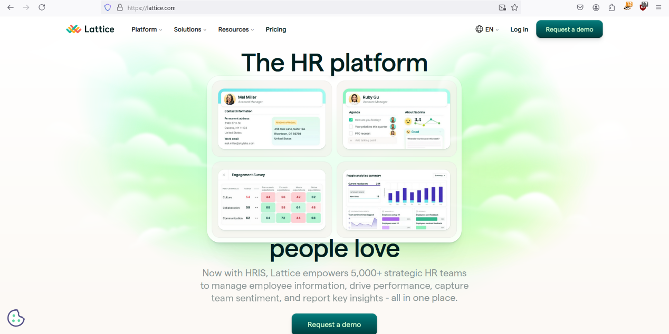
Lattice

Slide 18
CHAPTER III
01
INTRODUCTION
04
DATA FLOW DIAGRAM
02
SYSTEM DESCRIPTION
05
ERD
03
USE CASE DIAGRAM
06
DATA BASE DESIGN

Slide 19


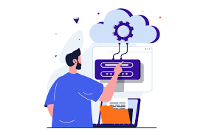


SYSTEM DESCRIPTION
Login
Show Personal Data
Reports
Managers Management
Project Management

Slide 20



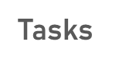
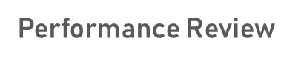
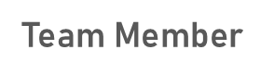
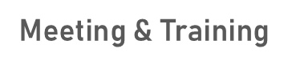
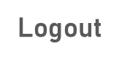
SYSTEM DESCRIPTION
Employees Management

Slide 21
SYSTEM DIAGRAMS
Use Case Diagram
Entity Relationship Diagram
Data Flow Diagram
Database Design

Slide 22
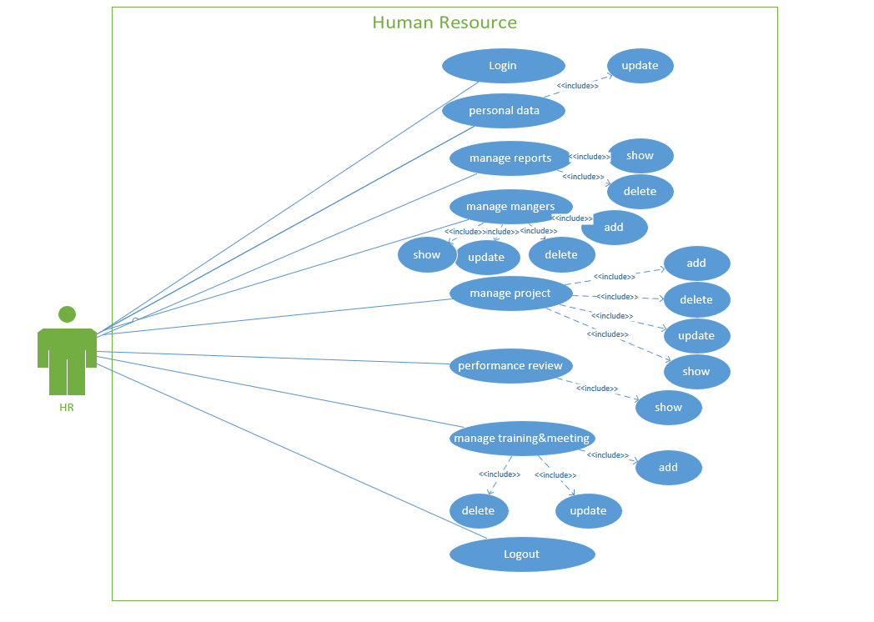
HR USE CASE
report

Slide 23
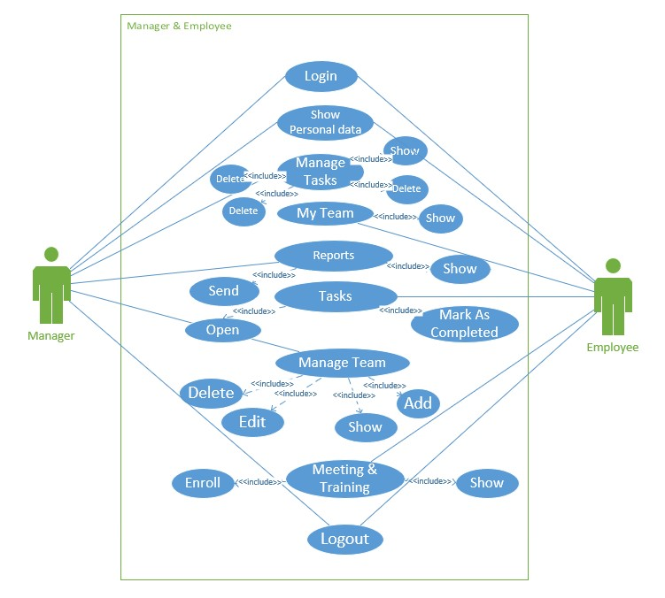
MANAGER & EMPLOYEES USE CASE

Slide 24
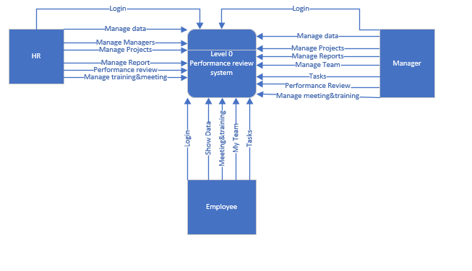
DATA FLOW LEVEL 0

Slide 25
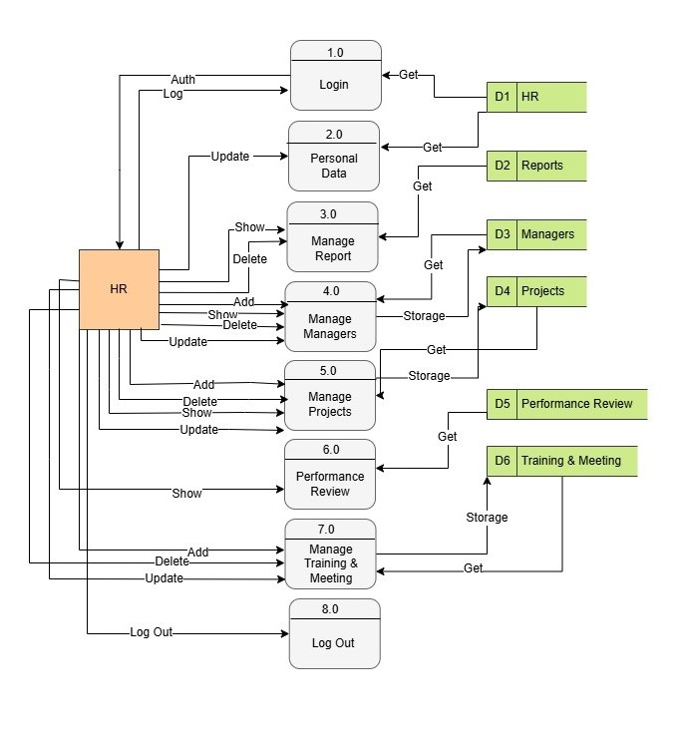
HR DATA FLOW LEVEL 1

Slide 26
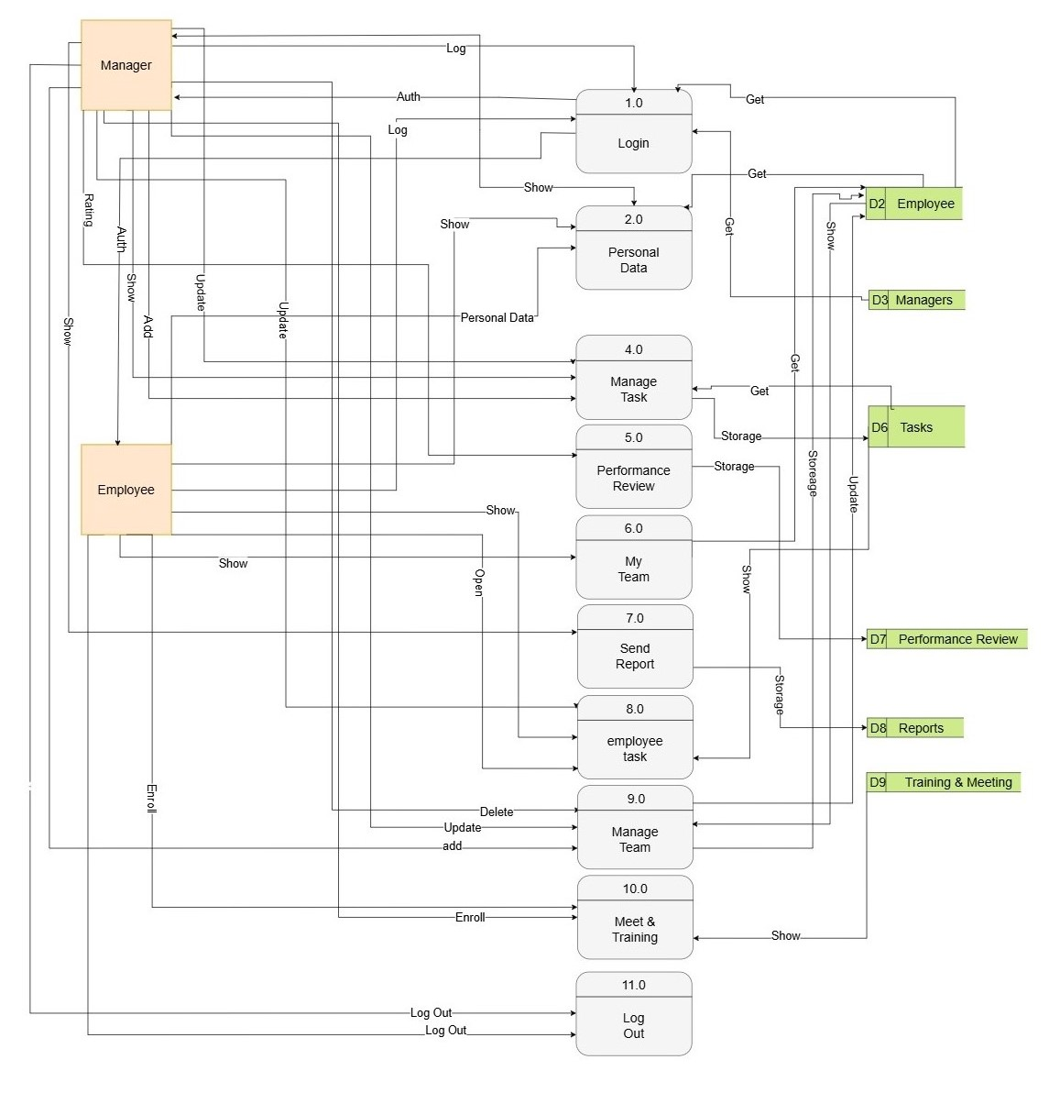
MANAGER & EMPLOYEE DATA FLOW LEVEL 1

Slide 27
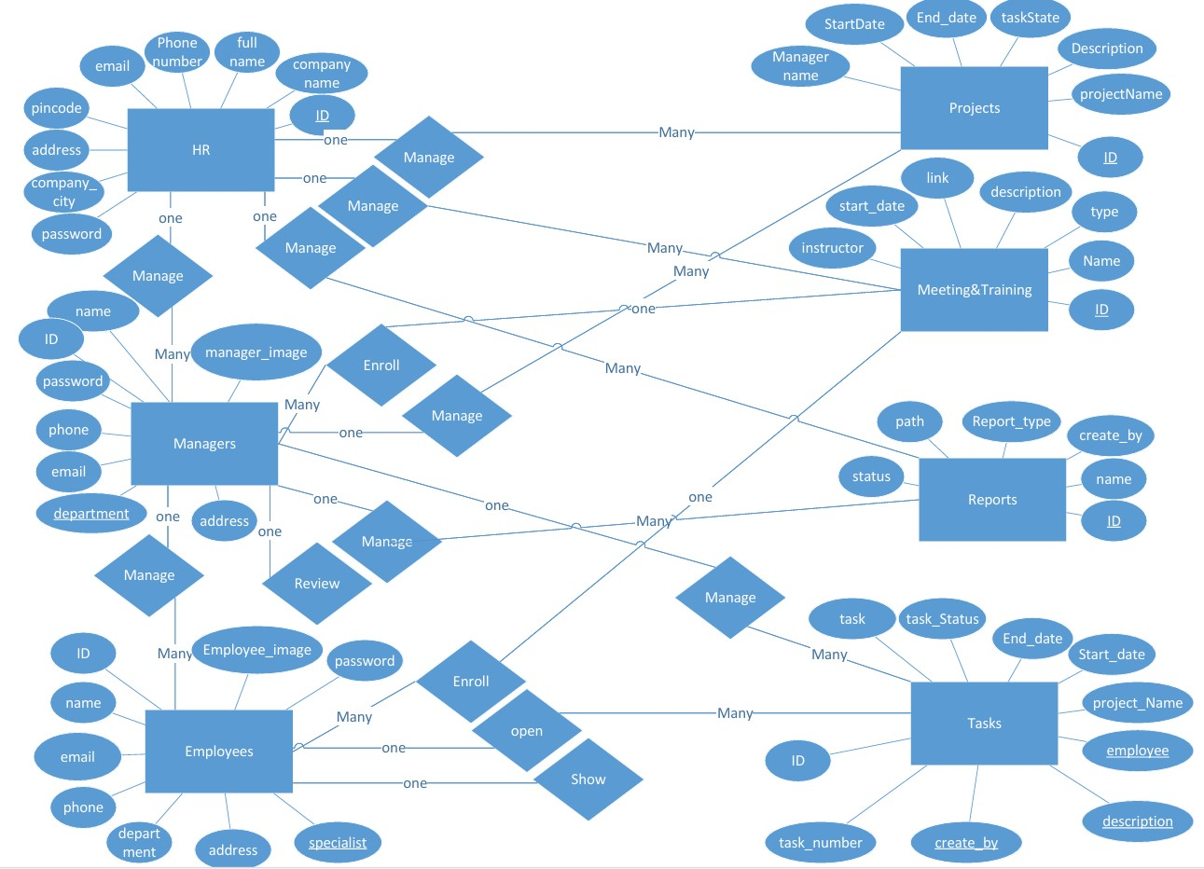
ENTITY RELATIONAL DIAGRAM(ERD)

Slide 28
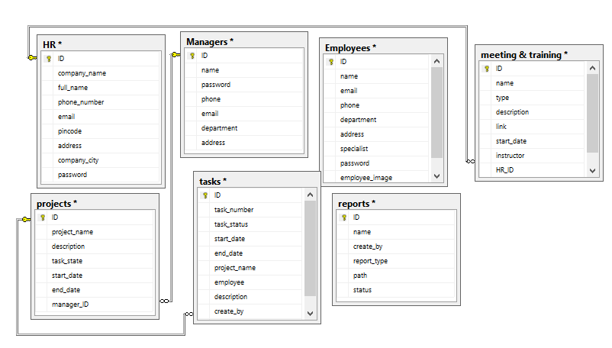
DATABASE DESIGN

Slide 29
CHAPTER IV
SYSTEM DESIGN
01
INTRODUCTION
02

Slide 30
INTRODUCTION
In this chapter we will introduce the most important user interfaces of our application. First, The home page for Welcome ,the login page which leads to three of the Dashboards (HR dashboard, Manager dashboards, and employee dashboards, The operations and characteristics of each page will be explained, such as the projects addition and modification page, managers, employees addition and modification, the reports page, the performance review page, and other pages that will also be mentioned in this chapter.

Slide 31
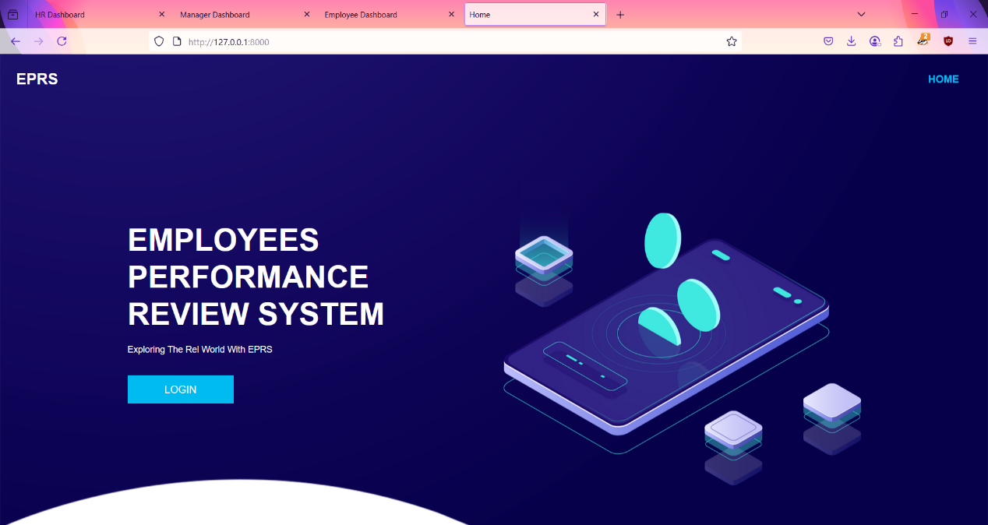
HOME PAGE

Slide 32
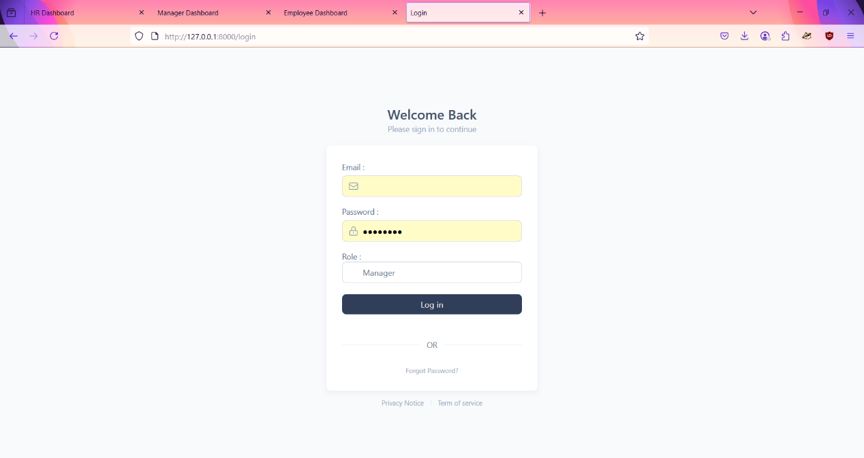
LOGIN PAGE

Slide 33
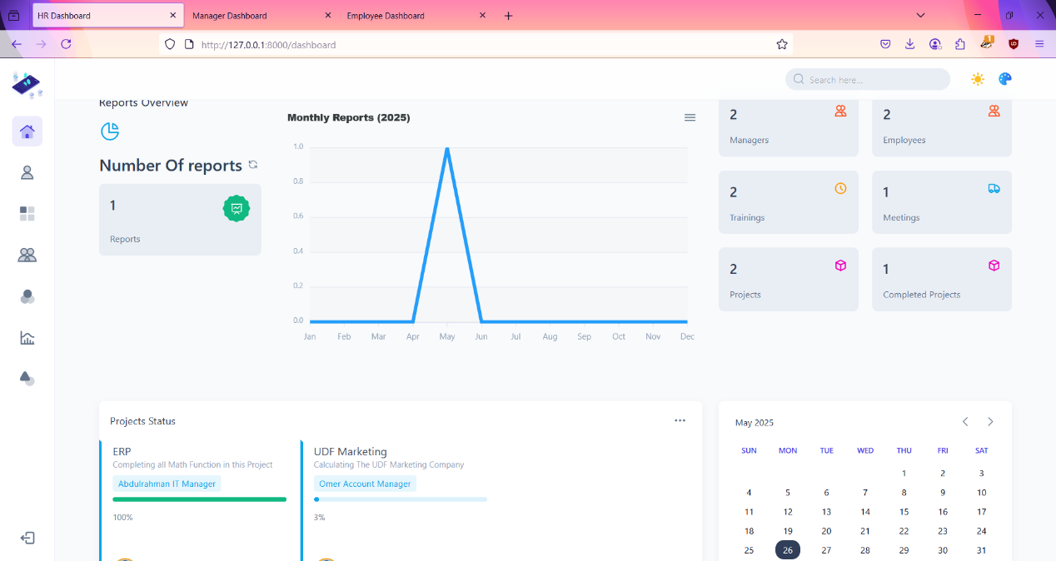
HR DASHBOARD

Slide 34
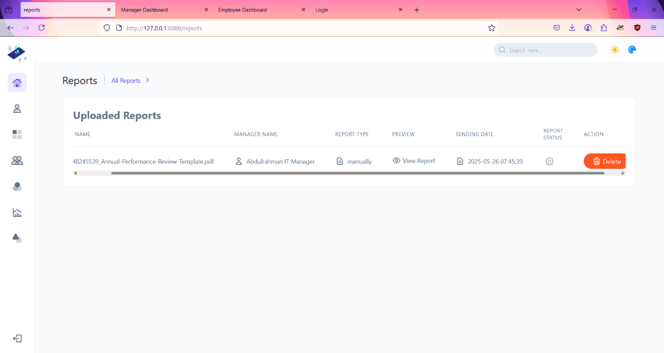
HR MANAGE REPORTS

Slide 35
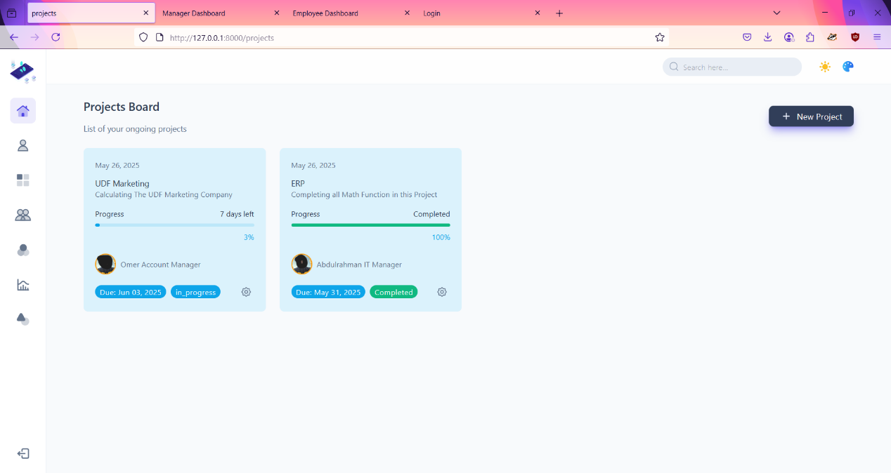
HR MANAGE PROJECTS

Slide 36
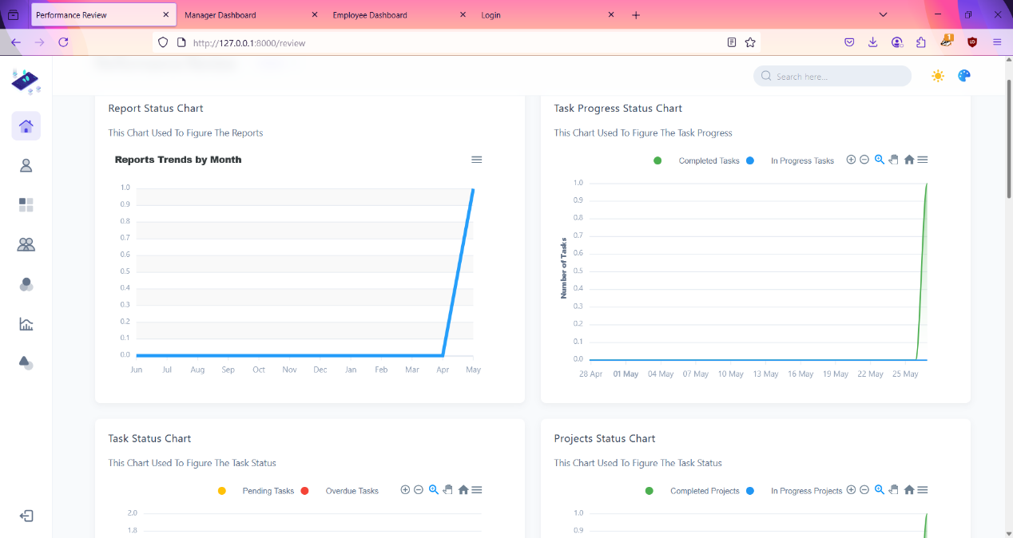
HR PERFORMANCE REVIEW

Slide 37
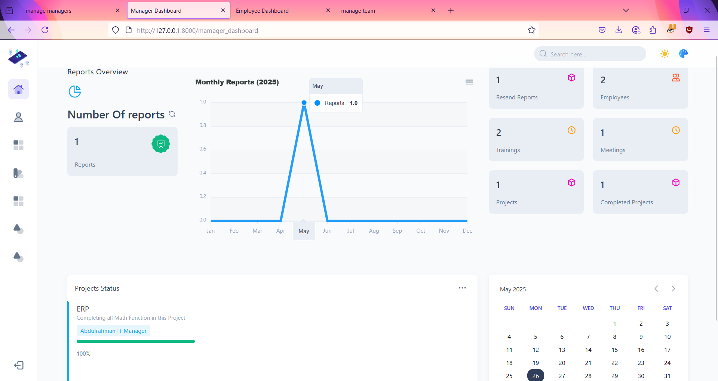
MANAGERS DASHBOARD

Slide 38
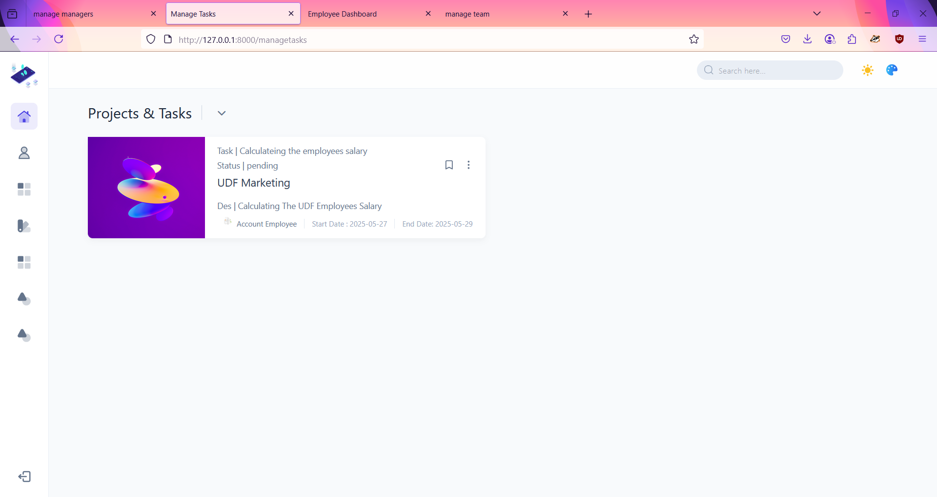
MANAGE TASKS

Slide 39
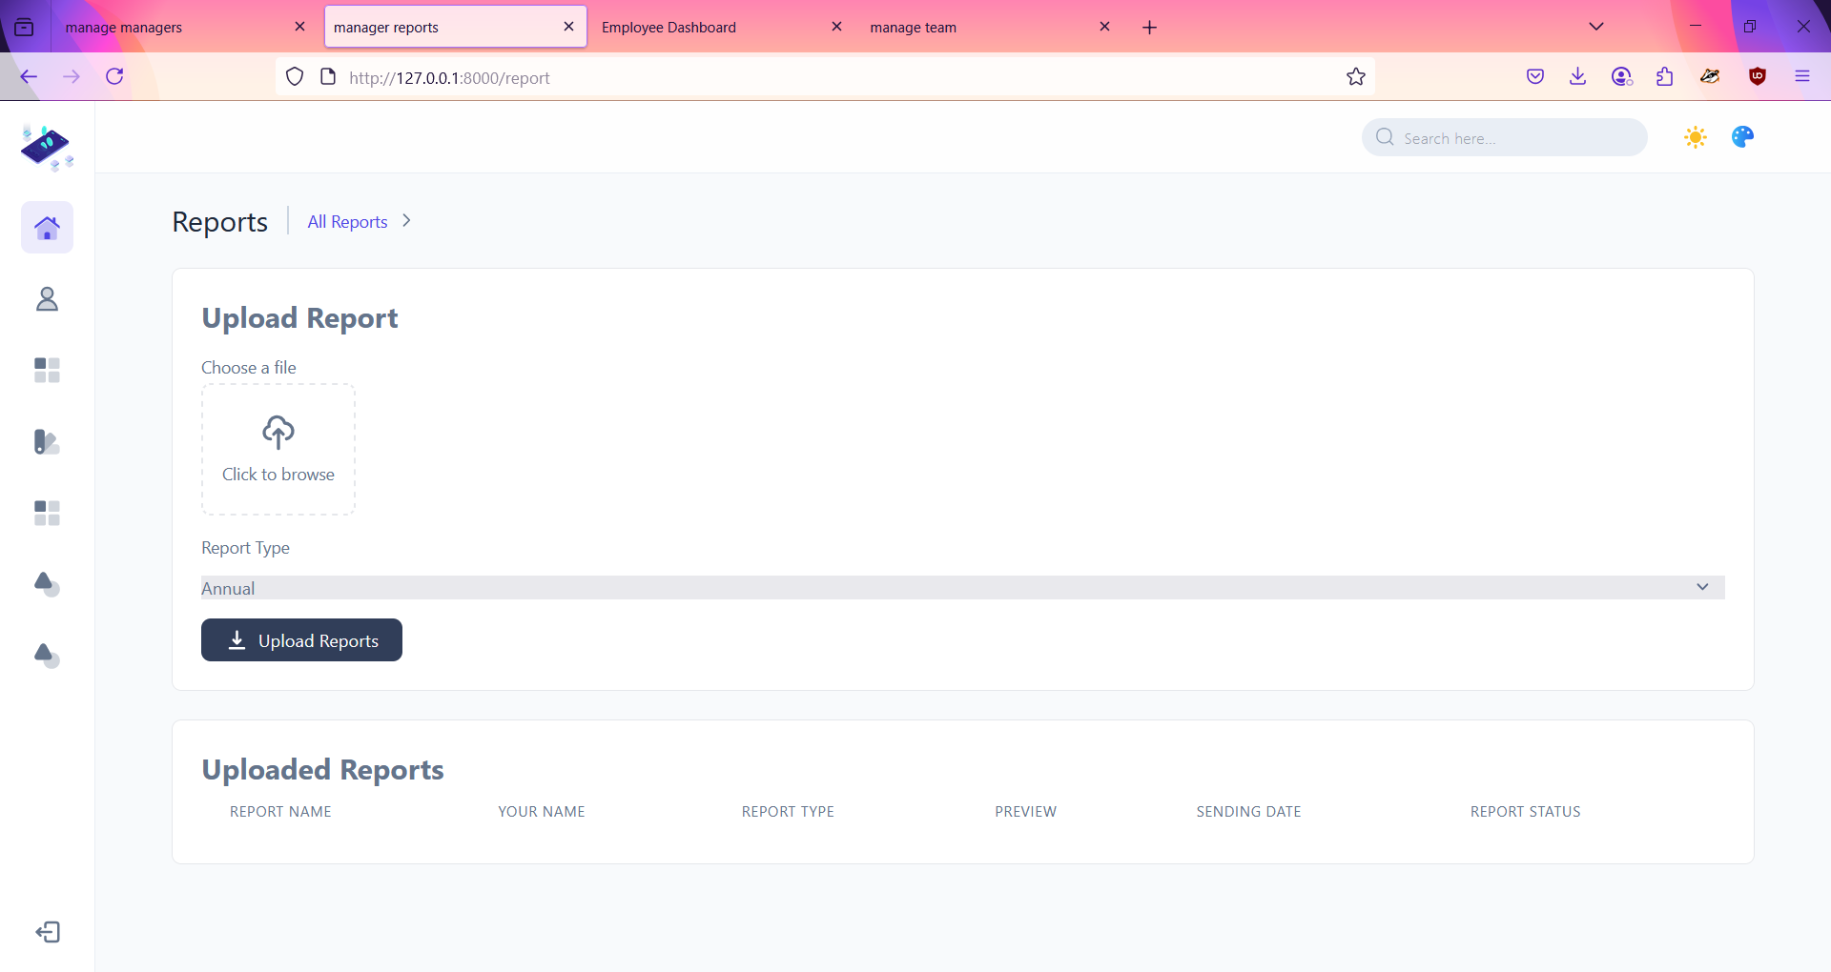
MANAGERS SEND REPORTS

Slide 40
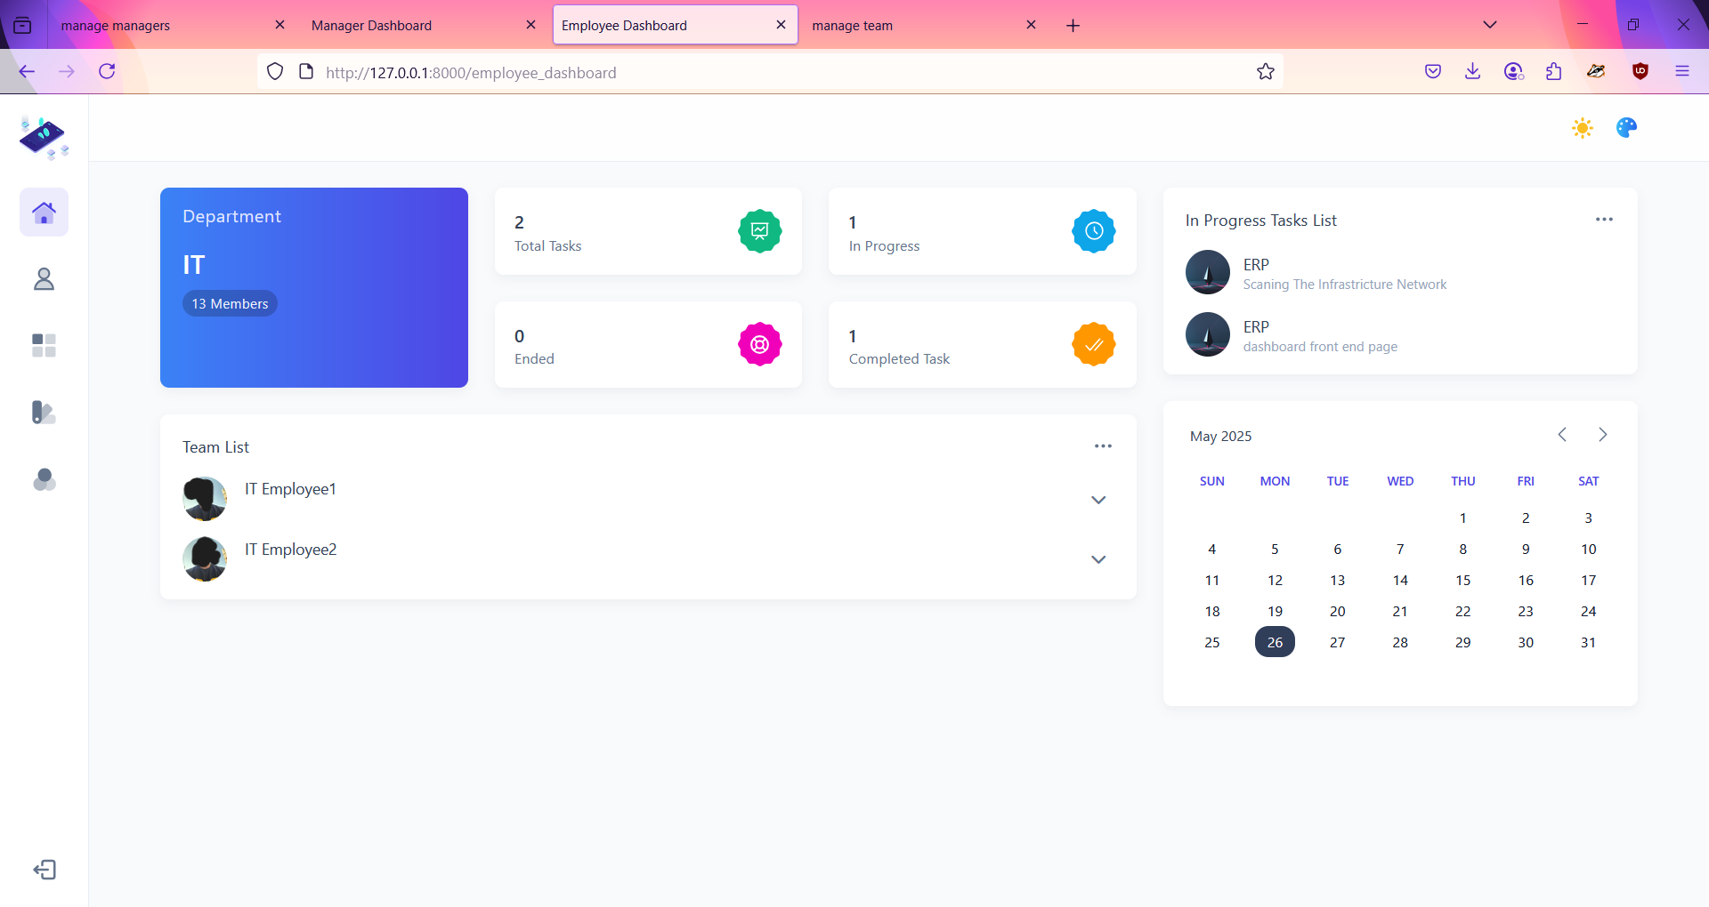
EMPLOYEES DASHBOARD

Slide 41
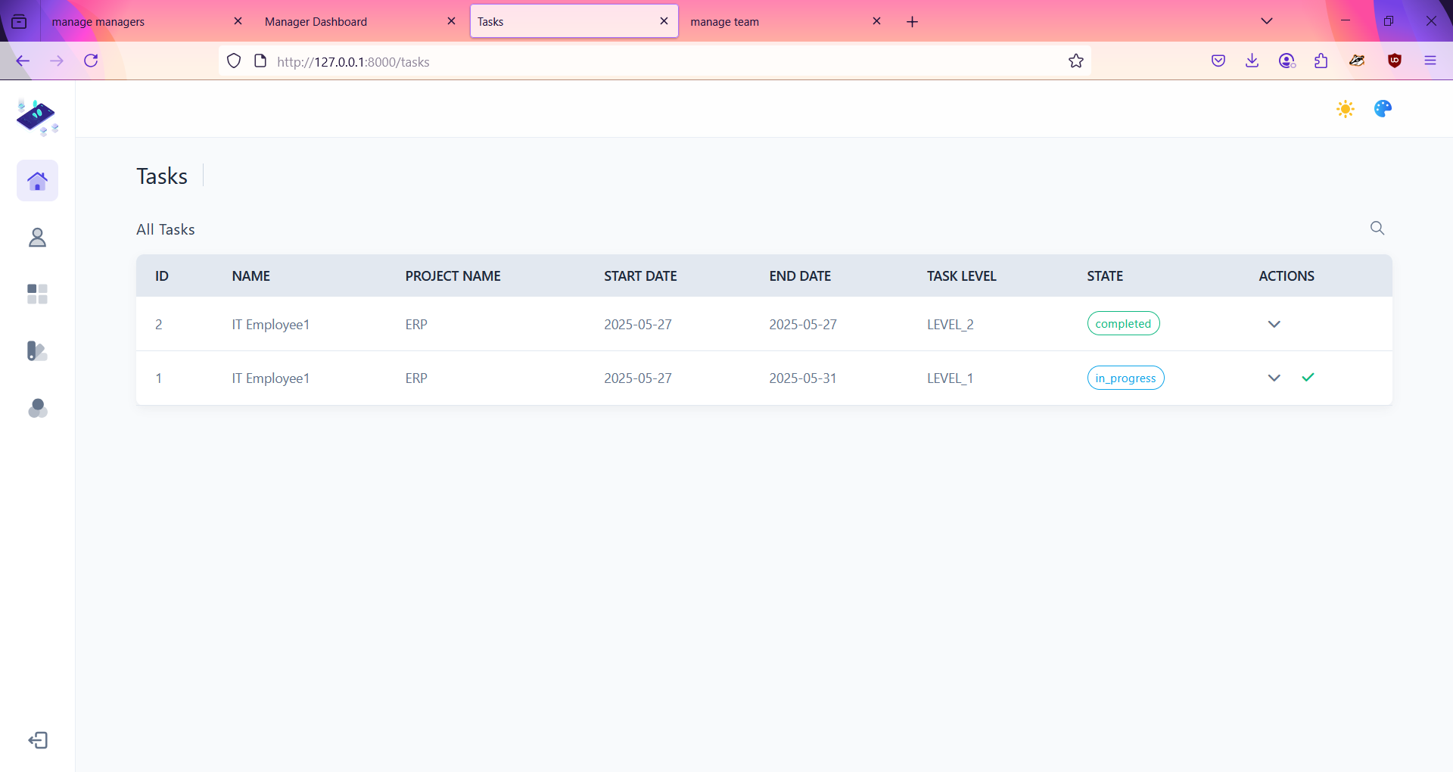
EMPLOYEES TASKS

Slide 42
CHAPTER V
FUTURE WORK
01
CONCLUSION
02

Slide 43
CONCLUSION
In conclusion, this Employee Performance Review System is designed to streamline and centralize the entire performance management workflow. By empowering HR to efficiently set up projects, assign management, and oversee the review process, while simultaneously enabling managers to effectively delegate tasks, track progress, and generate reports, and providing employees with clear visibility and control over their assignments, the system fosters enhanced accountability, transparency, and efficiency across the organization. Ultimately, it serves as a critical tool for driving continuous performance improvement and facilitating more objective and data-driven evaluations.

Slide 44
FUTURE WORKS
1- Support sending feedback form the managers to the HR.
2- Support sending feedback form the employees to their managers.
3-Sending reports as forms not as .bdf or other support files.
4-more analyzing for managers reports and it’s employees.
5-Employees can message or communicate with each other.
6-Visulaizing project in more analyzing and statistics .
7-Creating a centralizing performance review.
8- User interface additions and modifications.

Slide 45
THANK YOU FOR WATHCHING

